Slide 1
Industrial Hygiene sampling for the safety professional
Prepared by:
Karen Peissinger, Industrial Hygienist
University at Buffalo Environment, Health & Safety
Prepared for:
Niagara Frontier Chapter, ASSP
November 18, 2019

Slide 2
What will we cover?
Brief overview of industrial hygiene
IH Sampling
Sampling methods
Resources
Hands-on

Slide 3
Brief overview of Industrial hygiene
What is industrial hygiene?
Why “industrial”? Why “hygiene”?

Slide 4
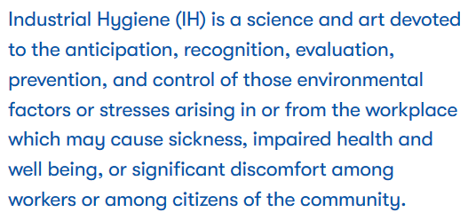
What is industrial hygiene?
“Industrial hygiene is the science of protecting and enhancing the health and safety of people at work and in their communities.” –ABIH
Image sources:
http://www.abih.org/content/ih-defined
https://www.aiha.org/

Slide 5
Why “industrial”? Why “hygiene”?
Source: https://www.bsoh.be/?q=en/node/48

Slide 6
IH sampling
What is IH sampling?
Why sample?
How to know how to sample?
OELs

Slide 7
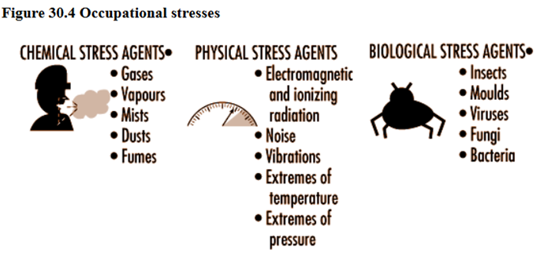
What is IH sampling?
“Chemical sampling and analysis is used by occupational health and safety professionals to assess workplace contaminants and associated worker exposure.”
Sources:
https://www.osha.gov/SLTC/samplinganalysis/index.html

Slide 8
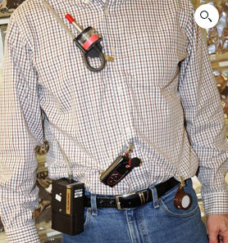
Why sample?
To answer the questions:
Who is exposed?
How much is the exposure?
Are the workers overexposed?
Are the engineering controls working?
Bonus: what is wrong with this picture?
Source:
https://www.safex.us/product/fundamentals-of-industrial-hygiene-nov-2019/
Notes:
1. Cyclone facing up, 2. passive badge not in breathing zone, 3. dosimeter not at shoulder (hearing zone), 4. pump not on back out of the way of work tasks

Slide 9
But, remember…
“…sampling should be performed only if the purpose is clear. [my emphasis] The occupational hygienist must ask, “What will be made of the sampling results and what questions will the results answer?” It is relatively easy to sample and obtain numbers; it is far more difficult to interpret them.” – Encyclopaedia of Occupational Health and Safety
Source:
http://www.ilocis.org/documents/chpt30e.htm

Slide 10
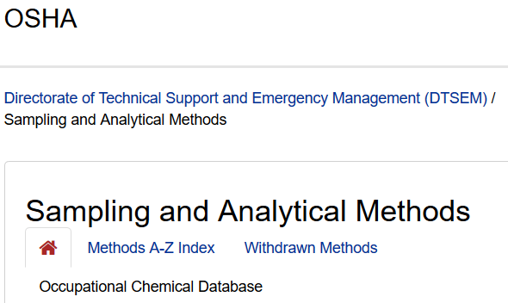
How to know how to sample?
Typically you will use a sampling method specified by NIOSH or OSHA.
The sampling method will specify:
Collection media
Air volume
Sampling rate
Sampling time
They typical provide the occupational exposure limit (OEL) applicable to the
Sources:
https://www.osha.gov/dts/sltc/methods/index.html
https://www.cdc.gov/niosh/npg/default.html

Slide 11
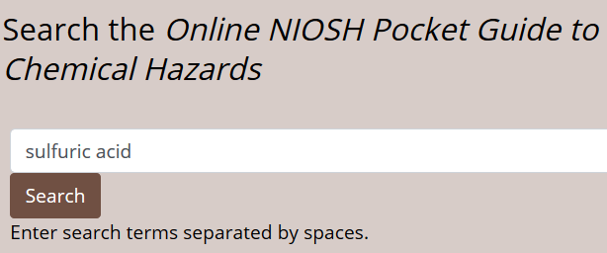
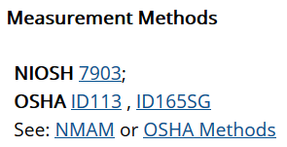
How to sample for sulfuric acid? (1 of 2)

Slide 12
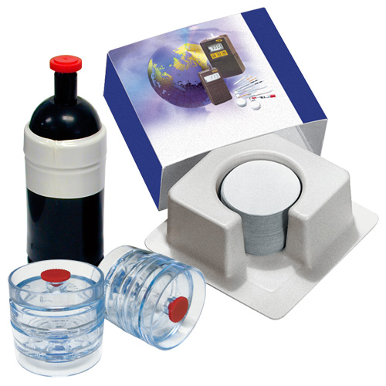
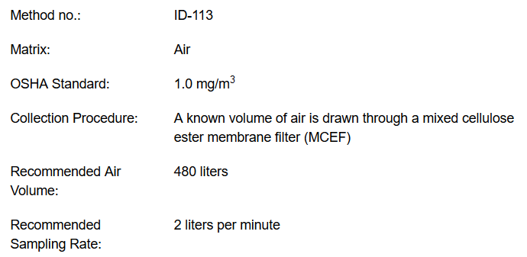
How to sample for sulfuric acid? (2 of 2)
Source: https://www.skcinc.com/catalog/index.php?cPath=300000000_301000000_301100000_301100150

Slide 13
OELs – occupational exposure limits
PEL – permissible exposure limit, OSHA
REL – recommended exposure limit, NIOSH
TLV* – threshold limit value, ACGIH
*copyrighted by ACGIH
Duchy of Oels
Source:
https://www.cdc.gov/niosh/npg/pgintrod.html

Slide 14
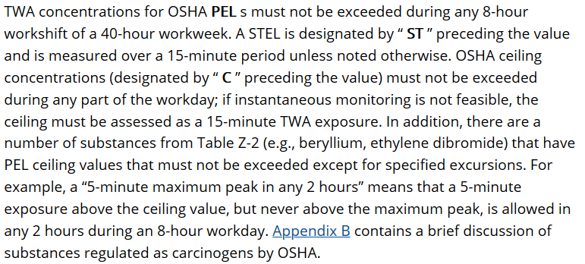
OSHA: PEL, ST, C

Slide 15
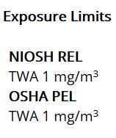
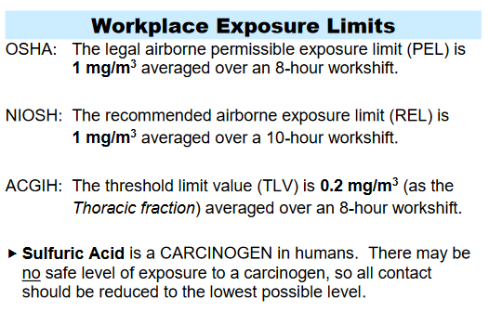
OELs for sulfuric acid
Source:
https://www.cdc.gov/niosh/npg/npgd0577.html
https://nj.gov/health/eoh/rtkweb/documents/fs/1761.pdf

Slide 16
IH sampling methods
Colorimetric tubes, chips & badges
Passive badges
Personal pumps & various media

Slide 17
Disclaimer
The following slides show images of products made by various manufacturers. The inclusion of these images does not imply endorsement of these products by Environment, Health & Safety nor University at Buffalo.

Slide 18
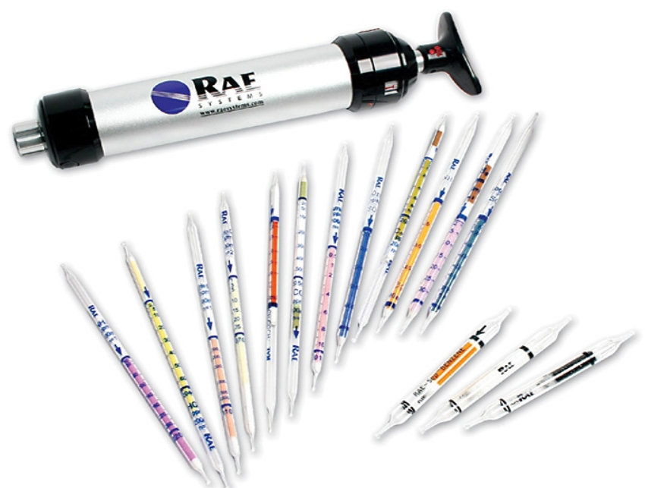
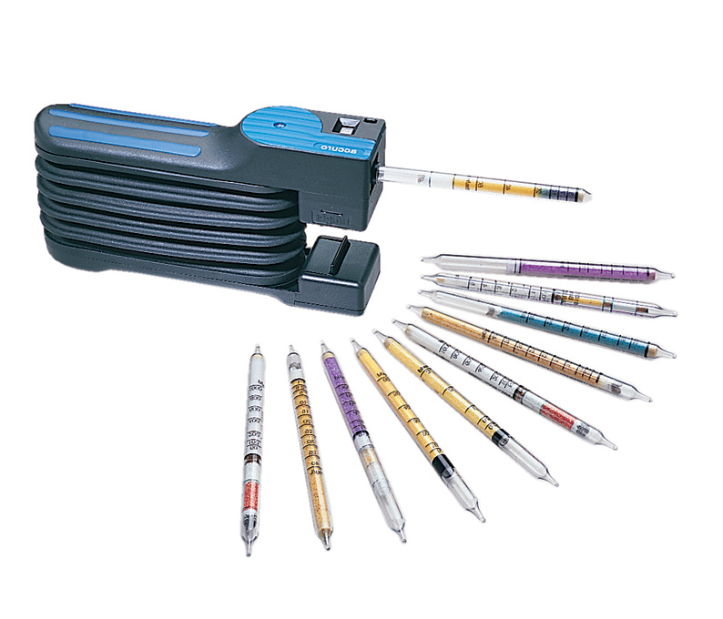
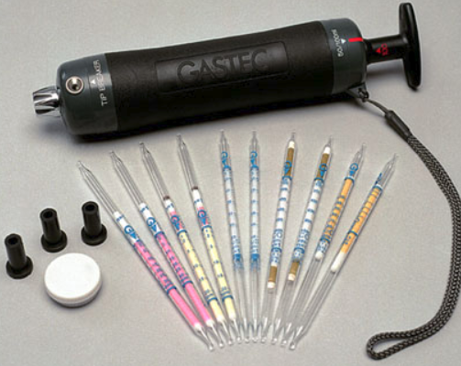
Colorimetric tubes
Source:
https://www.fishersci.com/shop/products/morphix-technologies-chromair-passive-sampling-badges-9/p-176771
https://www.gasdetectorshop.com/RAE-Piston-Hand-Pump-LP-1200-010-0001-000-p/rae%20tube%20pump.htm?gclid=EAIaIQobChMIw9-2jPTa5QIVA4TICh3hegkkEAQYByABEgJxQvD_BwE&Click=6504&utm_source=googleshopping&utm_medium=shoppingengine
Notes:
Beware of the broken glass tube ends!

Slide 19
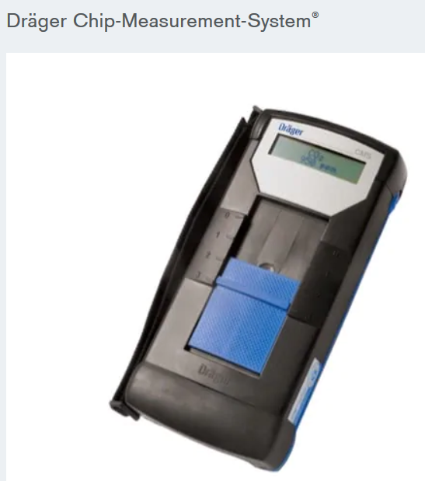
Colorimetric chips
Source:
https://www.draeger.com/en-us_us/Applications/Safety-Products

Slide 20
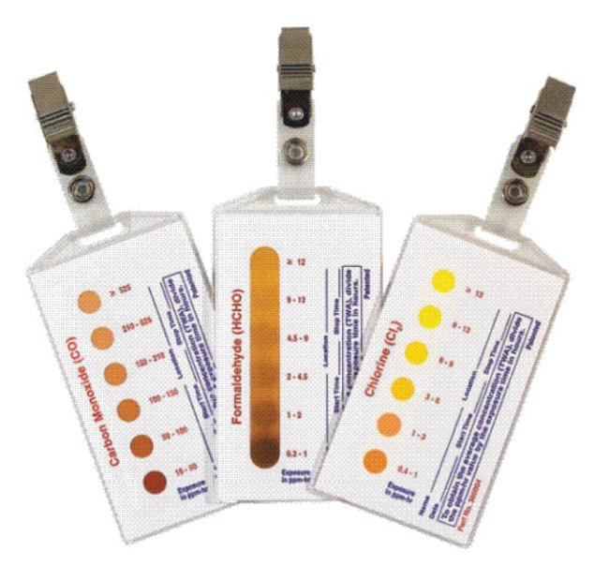
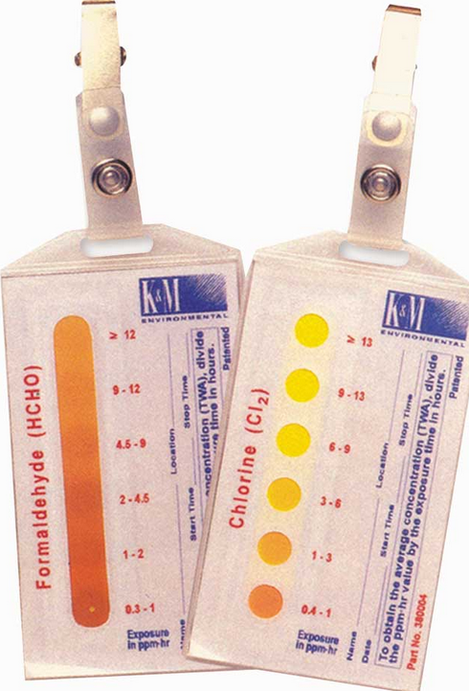
Colorimetric badges
Sources:
https://www.morphtec.com/chromair/

Slide 21
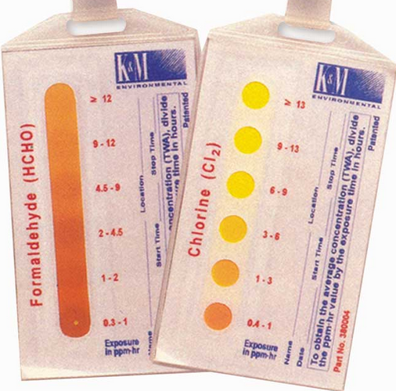
Colorimetric badge close up
Source: https://www.google.com/url?sa=i&rct=j&q=&esrc=s&source=images&cd=&ved=2ahUKEwjGztLE-9rlAhVHjlkKHQYOC28QjRx6BAgBEAQ&url=https%3A%2F%2Fwww.ereinc.com%2FBrowse%2FProduct%2F68%2F28%2FChromAir-Colorimetric-Badges-Direct-Read-Passive-Monitoring-System&psig=AOvVaw2vZ5orjhW2pJQ_oFdEsboT&ust=1573314306725023

Slide 22
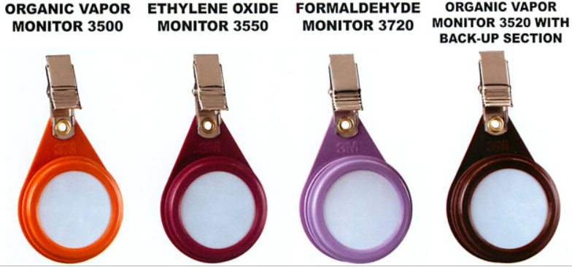
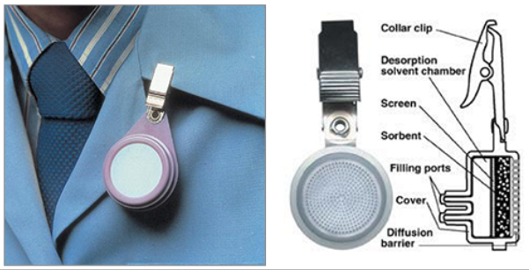
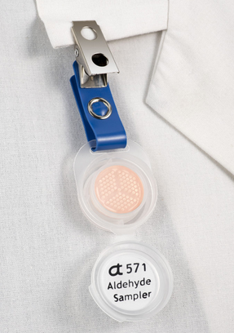
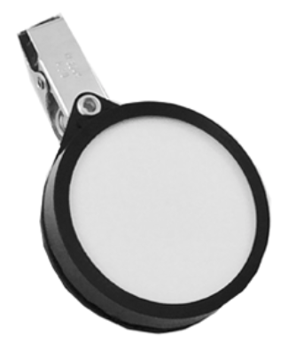
Passive badges
Source:
http://sphweb.bumc.bu.edu/otlt/mph-modules/ExposureAssessment/exposureassessment8.html
https://acsbadge.com/product/formaldehyde-vapor-monitor-f-50/
http://www.westernsafety.com/products/zefon/zefonpg6.html
https://www.assaytech.com/product/571-aldehyde-formaldehyde-monitor/

Slide 23
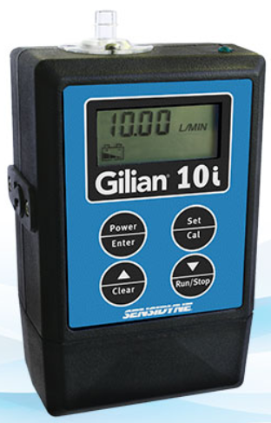
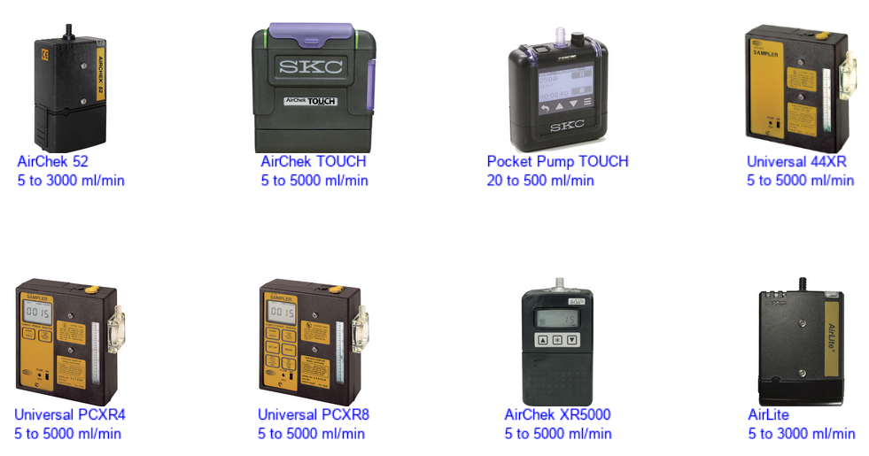
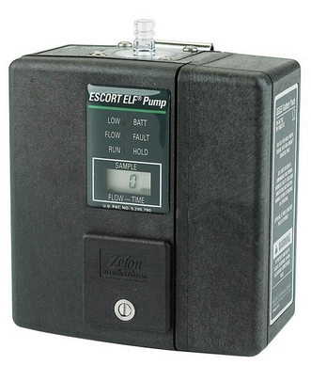
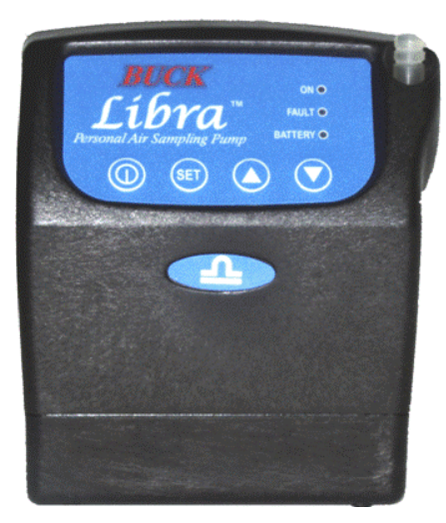
Personal pumps
Source:
https://www.apbuck.com/shop/item.aspx?itemid=30
https://www.sensidyne.com/air-sampling-equipment/gilian-air-sampling-pumps/gilian-10i-air-sampling-pump/
www.skcinc.com
Notes:
Some pumps display the flow rate. Trust, but verify.

Slide 24
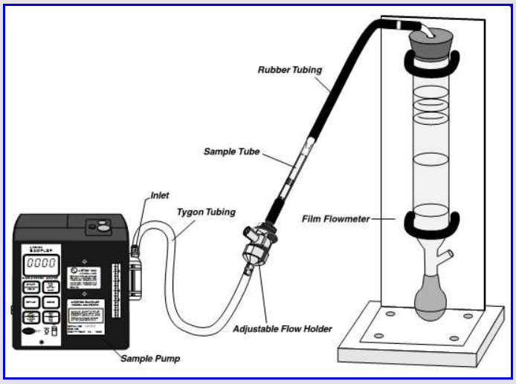
Bubble buret method

Slide 25
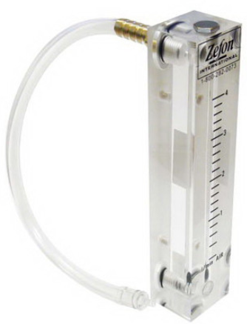
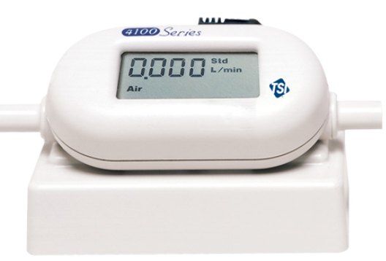
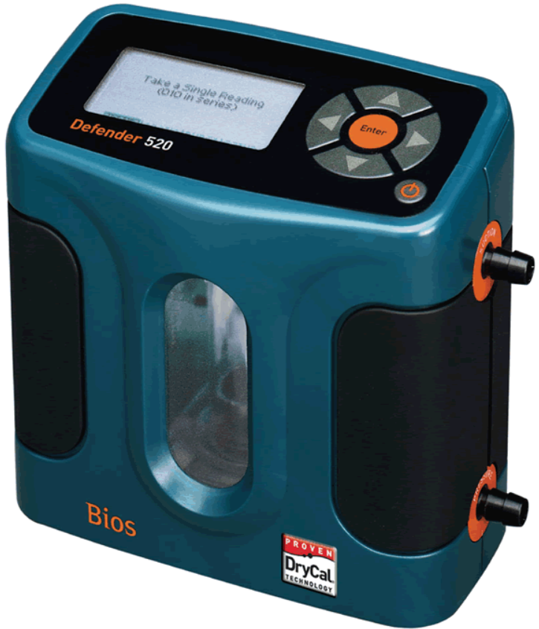
Primary & secondary calibrators
Source:
https://www.skcinc.com/catalog/index.php?cPath=100000000_103000000_103100000_103100300
https://www.brandtinst.com/bios/images/biosdefenderdrycal.gif
https://www.zefon.com/flowmeter-low-vol-non-adj-0-4-lpm
Notes:
Trust the primary. Verify the secondary.

Slide 26
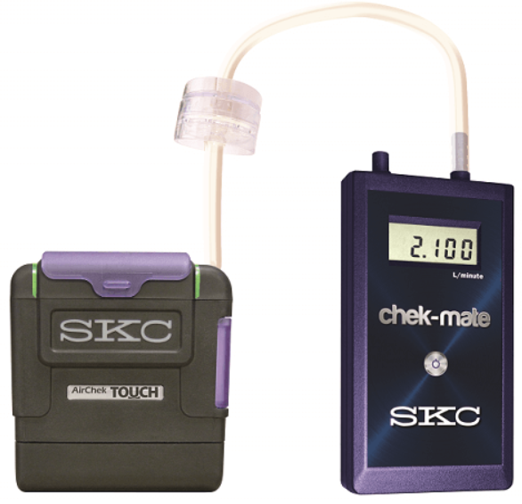
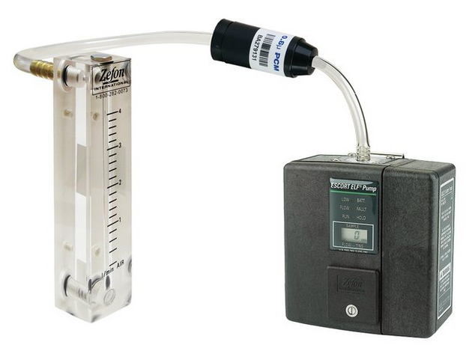
Calibration train
Source:
www.skcinc.com
www.zefon.com

Slide 27
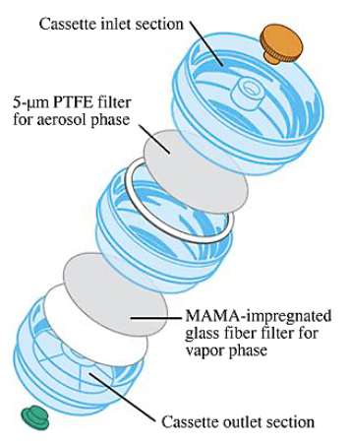
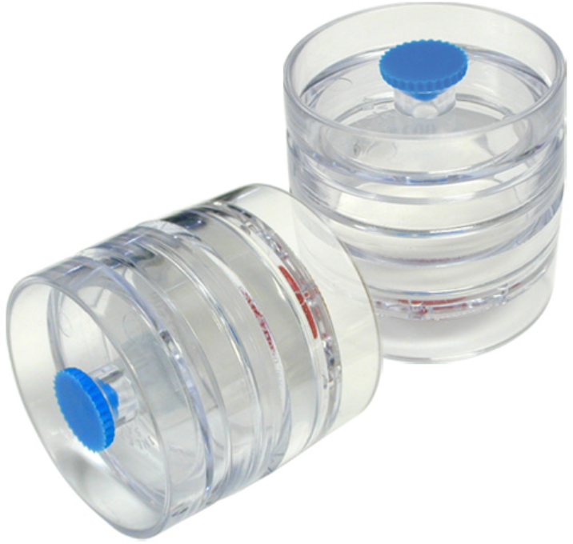
Filter cassettes
Source:
https://www.skcltd.com/products-category/100-filters-and-cassettes.html
www.skcinc.com

Slide 28
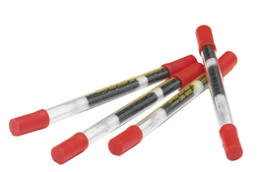
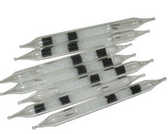
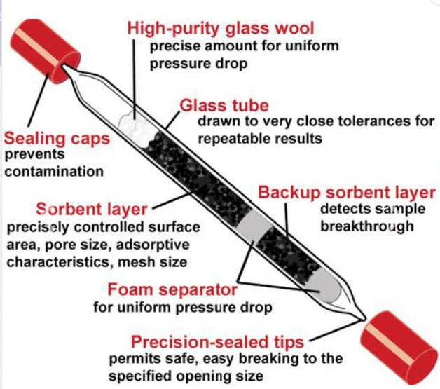
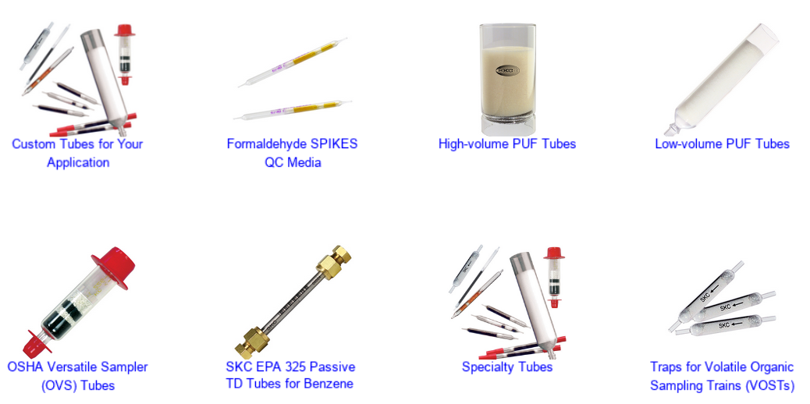
Sorbent tubes
Source:
https://www.skcinc.com/catalog/index.php?cPath=200000000_201000000_201100000
https://www.skcltd.com/products-category/101-sorbent-tubes.html
http://airsamplingsolutions.com/index.php/sorbent-tubes/

Slide 29
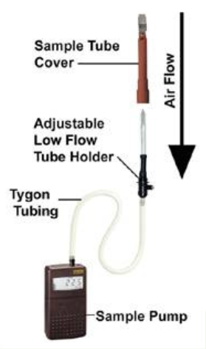
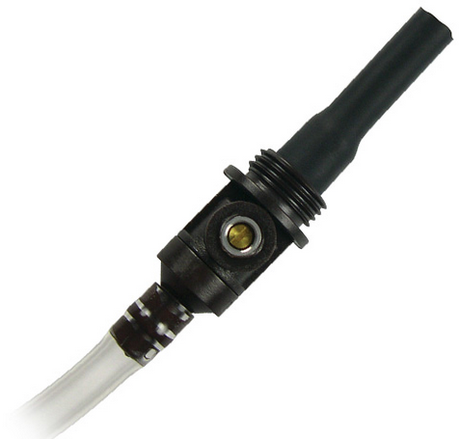
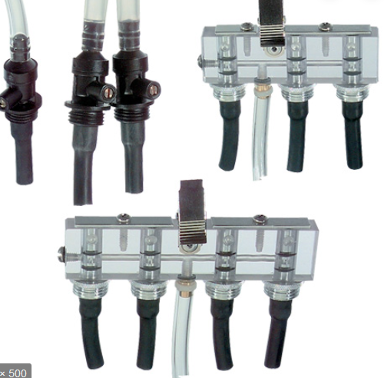
Sorbent tubes
Source:
http://ecoenvironmental.com.au/wp-content/uploads/How-Sorbent-Tube-Sampling-Works.pdf
www.skcinc.com

Slide 30
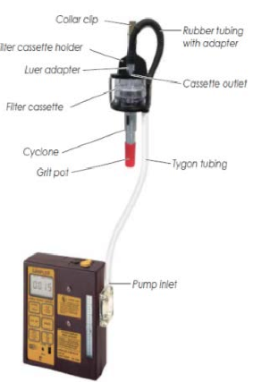
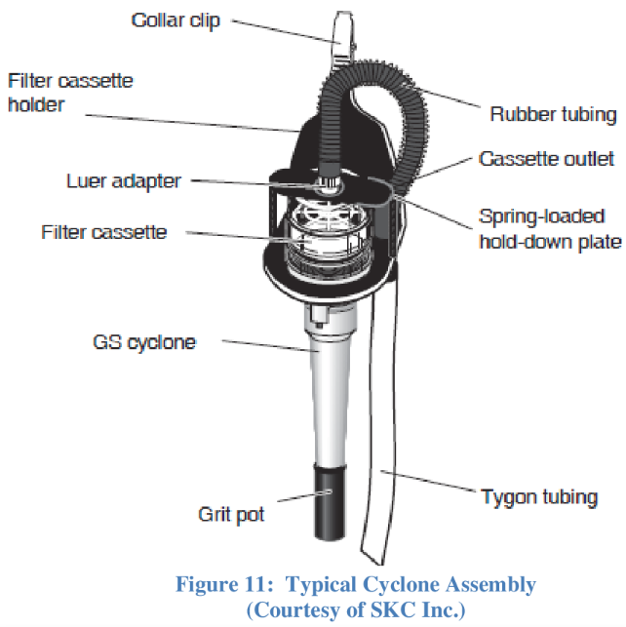
Cyclone attachment
Source:
https://www.semanticscholar.org/paper/U.S.-Air-Force-School-of-Aerospace-Medicine-and-Brown/1d3c579191fa6b82356a5b372cb97ad73993d520#extracted

Slide 31
Labs loan the equipment you need for sampling – FREE!
EMSL provides FREE PUMP RENTALS for your Industrial Hygiene Sampling Projects!
Notes:
SGS Galson has trademarked FreePumpLoan, so you know this is a hot trend in the analytical laboratory industry.

Slide 32
resources

Slide 33
ASSP IH Specialty Practice

Slide 34
ASSP Community Discussions

Slide 35
NFASSP LinkedIn

Slide 36
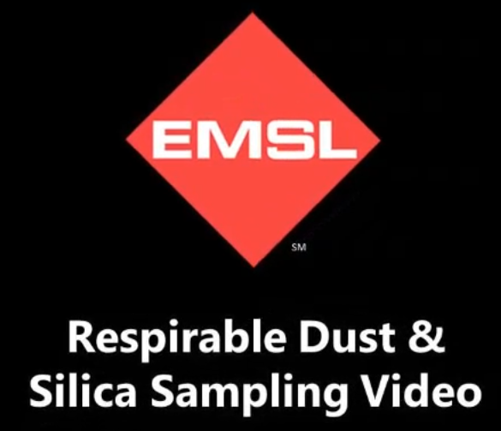
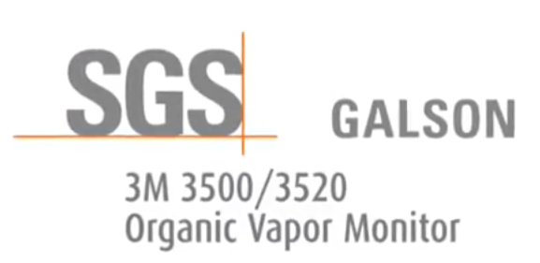
YouTube

Slide 37
The Internet
Introduction to Industrial Hygiene for the Safety Professional - Jeffery K. Dennis, MS, CSP, CHMM, CET, CSSM, WSO-CSE (https://www.insafetyconf.com/media/PDF/safety_conf_2014/materials/WC3.pdf)
Industrial Hygiene Sampling: Exposure Assessment – Keller Lecture 6, 2007-09-13 (http://www.chec.pitt.edu/documents/ExposAssessLectures/2504KellerLecture6.pdf)
FAQ- What does “employee exposure monitoring” mean? An Introduction to Industrial Hygiene Exposure Monitoring - Brookhaven National Laboratory, 2018-02-0 (https://www.bnl.gov/esh/shsd/sop/Construction_Contractor_IH/pdf/FAQ_IH_Sampling.pdf)
Industrial Hygiene in Review – Jim Kubisiak, MS, CIH, 2016 (https://mn.gov/admin/assets/Industrial%20Hygiene%20in%20Review%20Handout_tcm36-260009.pdf)
Yes, Even You Can Do Industrial Hygiene Air Sampling – EHS Today, 2003-05-20 (https://www.ehstoday.com/print/7787)

Slide 38
Do you have questions?
Feel free to contact me!
Karen Peissinger
University at Buffalo - Environment, Health & Safety
karenpei@buffalo.edu
716-829-5837
Photos taken by Karen Peissinger. Used with permission.
Notes:
The yellow, red and orange mushrooms appear to be waxycaps (Hygrocybe sp.). Photos taken in August 2017 at the Paul Smiths’s College Visitor Information Center outside Saranac Lake, NY.

